Slide 1
OpenGL Lab#3 (Transformation)
Computer Graphics

Slide 2
Transformations
Translate
Rotate
Scale

Slide 3
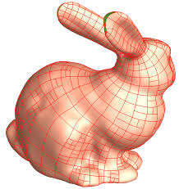
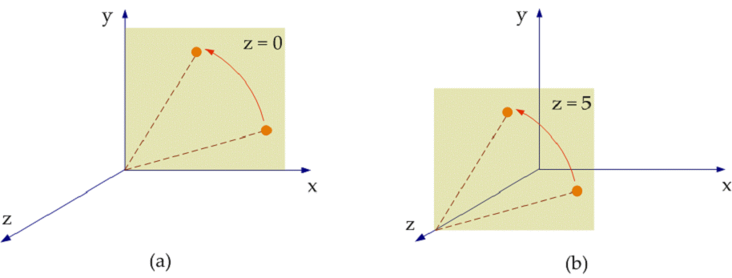
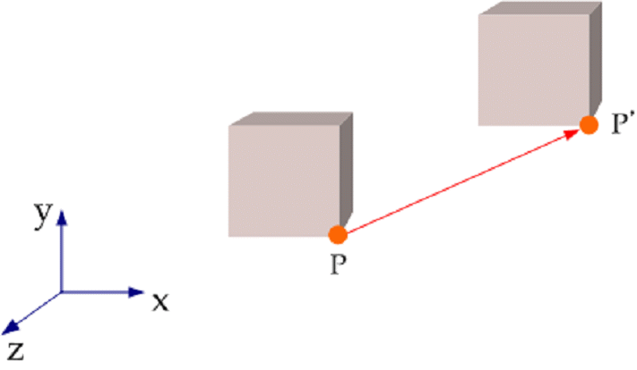
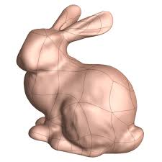
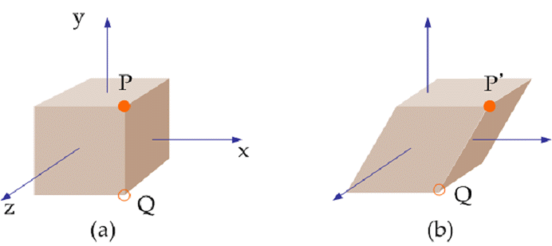
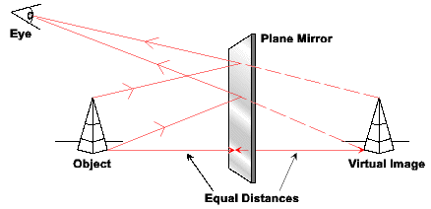
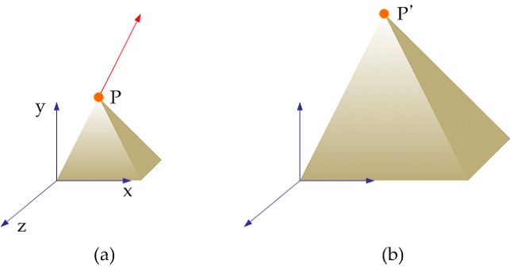
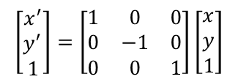
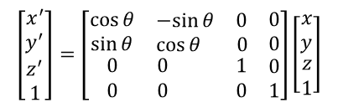
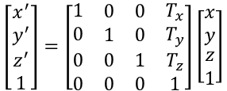
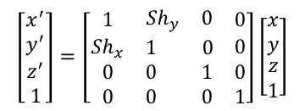
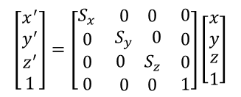
1. 3 Transform
Translation
Rotation
Transform
$$\left[\begin{matrix}x^{′} \\ y^{′} \\ \begin{aligned}z^{′} \\ 1\end{aligned}\end{matrix}\right]=\left[\begin{matrix}\cos{θ} & \begin{matrix}−sin{θ} & 0\end{matrix} & 0 \\ \sin{θ} & \begin{matrix}\cos{θ} & 0\end{matrix} & 0 \\ \begin{aligned}0 \\ 0\end{aligned} & \begin{aligned}\begin{matrix}0 & 1\end{matrix} \\ \begin{matrix}0 & 0\end{matrix}\end{aligned} & \begin{aligned}0 \\ 1\end{aligned}\end{matrix}\right]\left[\begin{matrix}x \\ y \\ \begin{aligned}z \\ 1\end{aligned}\end{matrix}\right]$$
$$\left[\begin{matrix}x^{′} \\ y^{′} \\ \begin{aligned}z^{′} \\ 1\end{aligned}\end{matrix}\right]=\left[\begin{matrix}1 & \begin{matrix}0 & 0\end{matrix} & T_{x} \\ 0 & \begin{matrix}1 & 0\end{matrix} & T_{y} \\ \begin{aligned}0 \\ 0\end{aligned} & \begin{aligned}\begin{matrix}0 & 1\end{matrix} \\ \begin{matrix}0 & 0\end{matrix}\end{aligned} & \begin{aligned}T_{z} \\ 1\end{aligned}\end{matrix}\right]\left[\begin{matrix}x \\ y \\ \begin{aligned}z \\ 1\end{aligned}\end{matrix}\right]$$
Scaling
Shearing
Reflection
$$\left[\begin{matrix}x^{′} \\ y^{′} \\ \begin{aligned}z^{′} \\ 1\end{aligned}\end{matrix}\right]=\left[\begin{matrix}1 & \begin{matrix}Sh_{y} & 0\end{matrix} & 0 \\ Sh_{x} & \begin{matrix}1 & 0\end{matrix} & 0 \\ \begin{aligned}0 \\ 0\end{aligned} & \begin{aligned}\begin{matrix}0 & 1\end{matrix} \\ \begin{matrix}0 & 0\end{matrix}\end{aligned} & \begin{aligned}0 \\ 1\end{aligned}\end{matrix}\right]\left[\begin{matrix}x \\ y \\ \begin{aligned}z \\ 1\end{aligned}\end{matrix}\right]$$
$$\left[\begin{matrix}x^{′} \\ y^{′} \\ 1\end{matrix}\right]=\left[\begin{matrix}1 & 0 & 0 \\ 0 & −1 & 0 \\ 0 & 0 & 1\end{matrix}\right]\left[\begin{matrix}x \\ y \\ 1\end{matrix}\right]$$
$$\left[\begin{matrix}x^{′} \\ y^{′} \\ \begin{aligned}z^{′} \\ 1\end{aligned}\end{matrix}\right]=\left[\begin{matrix}S_{x} & \begin{matrix}0 & 0\end{matrix} & 0 \\ 0 & \begin{matrix}S_{y} & 0\end{matrix} & 0 \\ \begin{aligned}0 \\ 0\end{aligned} & \begin{aligned}\begin{matrix}0 & S_{z}\end{matrix} \\ \begin{matrix}0 & 0\end{matrix}\end{aligned} & \begin{aligned}0 \\ 1\end{aligned}\end{matrix}\right]\left[\begin{matrix}x \\ y \\ \begin{aligned}z \\ 1\end{aligned}\end{matrix}\right]$$

Slide 4
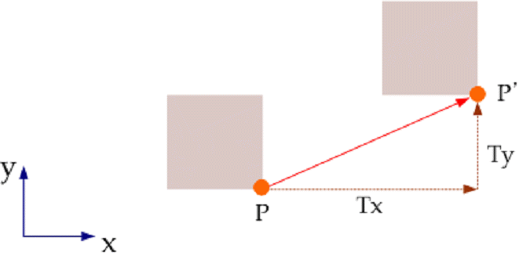
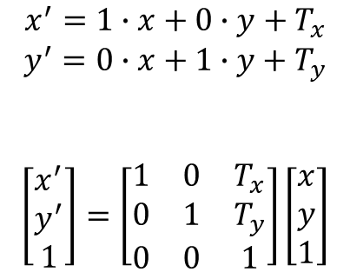
2.1 Translation (이동)
$$x^{′}=1∙x+0∙y+T_{x}$$
$$y^{′}=0∙x+1∙y+T_{y}$$
$$\left[\begin{matrix}x^{′} \\ y^{′} \\ 1\end{matrix}\right]=\left[\begin{matrix}1 & 0 & T_{x} \\ 0 & 1 & T_{y} \\ 0 & 0 & 1\end{matrix}\right]\left[\begin{matrix}x \\ y \\ 1\end{matrix}\right]$$
OpenGL 함수: Move an object by x, y, z value
glTranslatef(x, y, z)
glTranslatef(0.6, 0.0, 0.0)

Slide 5
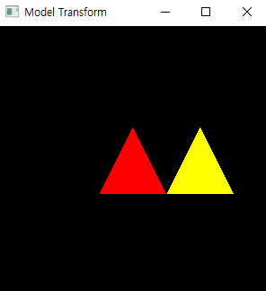
2.1 Translation (이동)
def MyDisplay:
glClear(GL_COLOR_BUFFER_BIT)
glMatrixMode(GL_MODELVIEW)
glLoadIdentity( )
glColor3f(1.0, 0.0, 0.0) #red
#model 넣기
glTranslatef(0.6, 0.0, 0.0) # move to x-axis
glColor3f(1.0, 1.0, 0.0) #yellow
# model 넣기
glFlush( )
}

Slide 6
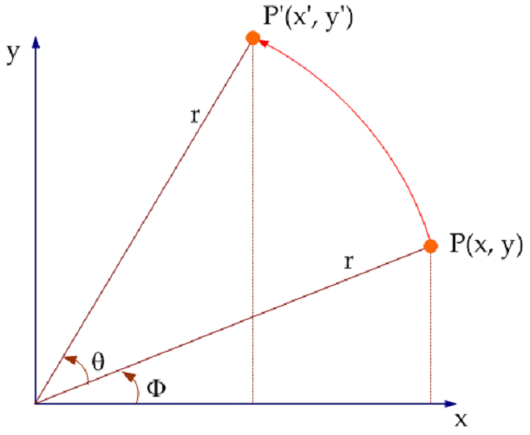
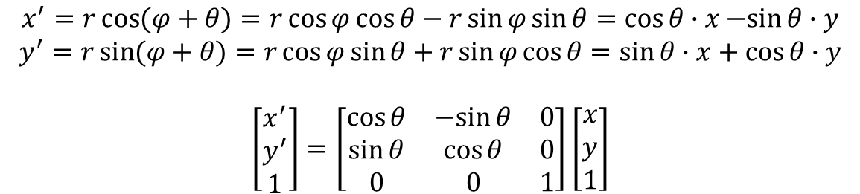
2.2 Rotation (회전)
$$x^{′}=r\cos{(φ+θ)}=r\cos{φ\cos{θ}}−r\sin{φ\sin{θ}}=\cos{θ}∙x−sin{θ}∙y$$
$$y^{′}=r\sin{(φ+θ)}=r\cos{φ\sin{θ}}+r\sin{φ\cos{θ}}=\sin{θ}∙x+\cos{θ}∙y$$
$$\left[\begin{matrix}x^{′} \\ y^{′} \\ 1\end{matrix}\right]=\left[\begin{matrix}\cos{θ} & −sin{θ} & 0 \\ \sin{θ} & \cos{θ} & 0 \\ 0 & 0 & 1\end{matrix}\right]\left[\begin{matrix}x \\ y \\ 1\end{matrix}\right]$$
OpenGL 함수: rotate an object by angle on the axis
glRotatef(angle, x, y, z)
angle :
45, 60 degree
x, y, z : rotational axis
X-axis rotation : 1, 0, 0
Y-axis rotation : 0, 1, 0
Z-axis rotation : 0, 0, 1

Slide 7
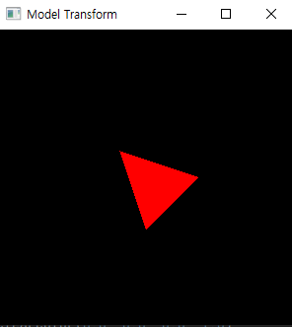
2.2 Rotation (회전)
def MyDisplay:
glClear(GL_COLOR_BUFFER_BIT)
glMatrixMode(GL_MODELVIEW)
glLoadIdentity( )
glRotatef( 45, 0.0, 0.0, 1.0 ) #45 ° rotation on z-axis
glColor3f(1.0, 0.0, 0.0) #red cube
glutSolidCube(0.3)
glFlush( )

Slide 8
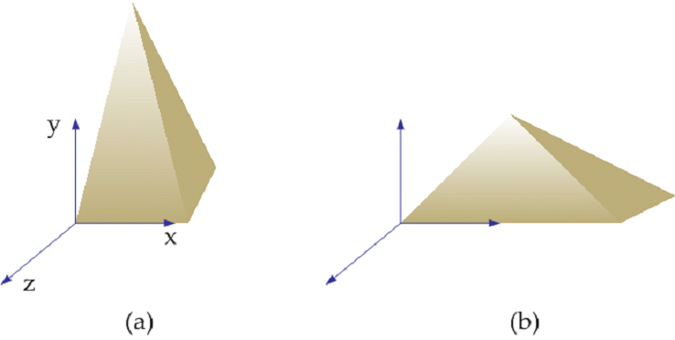
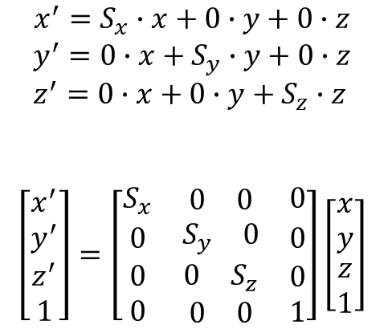
2.3 Scaling (크기조절)
$$x^{′}=S_{x}∙x+0∙y+0∙z$$
$$y^{′}=0∙x+S_{y}∙y+0∙z \\ z^{′}=0∙x+0∙y+S_{z}∙z$$
$$\left[\begin{matrix}x^{′} \\ y^{′} \\ \begin{aligned}z^{′} \\ 1\end{aligned}\end{matrix}\right]=\left[\begin{matrix}S_{x} & \begin{matrix}0 & 0\end{matrix} & 0 \\ 0 & \begin{matrix}S_{y} & 0\end{matrix} & 0 \\ \begin{aligned}0 \\ 0\end{aligned} & \begin{aligned}\begin{matrix}0 & S_{z}\end{matrix} \\ \begin{matrix}0 & 0\end{matrix}\end{aligned} & \begin{aligned}0 \\ 1\end{aligned}\end{matrix}\right]\left[\begin{matrix}x \\ y \\ \begin{aligned}z \\ 1\end{aligned}\end{matrix}\right]$$
OpenGL 함수
glScalef(1.0, 2.0, 0.5)
X => the same
Y => 2 times the size
Z => half in size

Slide 9
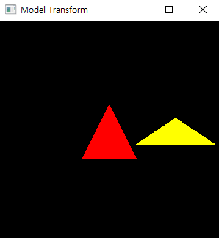
2.3 Scaling (크기조절)
def MyDisplay():
glColor3f(1.0, 0.0, 0.0)
glutSolidCube(0.3)
glTranslatef(0.6, 0.0, 0.0)
glScalef(1.5, 0.5, 0.5 )
glColor3f(1.0, 1.0, 0.0)
glutSolidCube(0.3)
glFlush( )

Slide 10
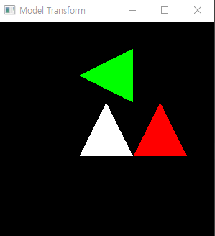
Lab#3
문제) 다음 모양이 출력되도록 삼각형(vertex로 그리기)을 변환하는 코드를 작성하시오.

Slide 11
제출
보고서 내용 (pdf)
문제에서 요구하는 각 세부 기능 설명
기능별 실행 화면 캡춰
전체 프로그램 코드
보고서 pdf (lab0#_학번_이름.pdf)
실행파일 (lab0#_학번_이름.py)
위의 2개 파일을 zip으로 압축(lab0#_학번_이름.zip)

